Slide 1

Streaming Algorithms: Data without a disk
CS 450 – Elements of Big Data
CS 550 – Big Data Management and Analytics
Dr. Mohammed Ayoub Alaoui Mhamdi
Bishop's University
Sherbrooke, Qc, Canada
malaoui@ubishops.ca

Slide 2
Big Data Analytics, The Class
Goal: Generalizations
A model or summarization of the data.
Data Frameworks
Algorithms and Analyses
Similarity Search
Hadoop File System
Spark
Hypothesis Testing
Graph Analysis
Streaming
Recommendation Systems Deep Learning
MapReduce
Tensorflow

Slide 3


What is Streaming?
Broadly:
Process
RECORD IN
RECORD GONE

Slide 4
Why Streaming?
Direct: Often, data …
… cannot be stored (too big, privacy concerns)
… are not practical to access repeatedly (reading is too long)
… are rapidly arriving (need rapidly updated "results")

Slide 5
Why Streaming?
Direct: Often, data …
… cannot be stored (too big, privacy concerns)
… are not practical to access repeatedly (reading is too long)
… are rapidly arriving (need rapidly updated "results")
Examples: Google search queries
Satellite imagery data Text Messages, Status updates
Click Streams

Slide 6
Why Streaming?
Direct: Often, data …
… cannot be stored (too big, privacy concerns)
… are not practical to access repeatedly (reading is too long)
… are rapidly arriving (need rapidly updated "results")
Indirect: The constraints for streaming data force one to solutions that are often efficient even when storing data. Streaming Approx Random Sample
Distributed IO (MapReduce, Spark)

Slide 7
Why Streaming?
Often translates into O(N) or strictly N algorithms.t
● …
● …
● …
rivacy concerns)
epeatedly apidly updated
RECORD IN
_{Process}
_{RECORD GONE}
(2) Indirect: The constraints for streaming data force one to solutions that are often efficient even when storing data. Streaming Approx Random Sample
Distributed IO (MapReduce, Spark)

Slide 8
Streaming Topics
General Stream Processing Model
Sampling
Counting Distinct Elements
Filtering data according to a criteria

Slide 9



Process
for stream queries
RECORD IN
RECORD GONE
Ad-Hoc:
One-time questions
-- must store expected parts / summaries of streams
Standing Queries:
Stored and permanently executing.

Slide 10
Process
for stream queries
RECORD IN
RECORD GONE
Ad-Hoc:
One-time questions
-- must store expected parts / summaries of streams
Standing Queries:
Stored and permanently executing.
E.g. How would you handle:
What is the mean of values seen so far?

Slide 11
Process
for stream queries
RECORD IN
RECORD GONE
Ad-Hoc:
Standing Queries: One-time questions
Stored and permanently executing. ^{-- must store expected parts /}
summaries of streams
Important difference from typical database management:
Input is not controlled by system staff.
Input timing/rate is often unknown, controlled by users.
E.g. How would you handle:
What is the mean of values seen so far?

Slide 12
Process
for stream queries
RECORD IN
RECORD GONE
Ad-Hoc:
Standing Queries: One-time questions
Stored and permanently executing. ^{-- must store expected parts /}
summaries of streams
Important difference from typical database management:
Might hold a sliding window of
records instead of single record.
Input is not controlled by system staff.
.. , i, h, g, b, a
Input timing/rate is often unknown, controlled by users.
f, e, d, c,
E.g. How would you handle:
What is the mean of values seen so far?

Slide 13


General Stream Processing Model
(Leskovec et al., 2014)
Processor
…, 4, 3, 11, 2, 0, 5, 8, 1, 4
Output
(Generalization, Summarization)
Input stream
A stream of records
(also often referred to as “elements” , “tuples”, "lines", or "rows")
Theoretically, could be anything! search queries, numbers, bits, image ﬁles, ...

Slide 14
General Stream Processing Model
ad-hoc queries
-- one-time questions
Processor
…, 4, 3, 11, 2, 0, 5, 8, 1, 4
Output
(Generalization, Summarization)
Input stream

Slide 15
General Stream Processing Model
ad-hoc queries
Processor
…, 4, 3, 11, 2, 0, 5, 8, 1, 4
standing queries
Output
(Generalization, Summarization)
Input stream
-- asked at all times.

Slide 16
General Stream Processing Model
ad-hoc queries
Processor
…, 4, 3, 11, 2, 0, 5, 8, 1, 4
standing queries
Output
(Generalization, Summarization)
Input stream
limited memory

Slide 17
General Stream Processing Model
ad-hoc queries
Processor
…, 4, 3, 11, 2, 0, 5, 8, 1, 4
standing queries
Output
(Generalization, Summarization)
Input stream
limited memory
archival storage
-- not suitable for fast queries.

Slide 18


Sampling
Create a random sample for statistical analysis.
RECORD IN
Process
RECORD GONE

Slide 19
Sampling
Create a random sample for statistical analysis.
RECORD IN
Process
RECORD GONE
Keep?
yes
limited memory

Slide 20
Sampling
Create a random sample for statistical analysis.
RECORD IN
Process
RECORD GONE
Keep?
yes
sometime in
future
limited memory
run statistical analysis

Slide 21
Sampling: 2 Versions
Create a random sample for statistical analysis.
1. Simple Sampling: Individual records are what you wish to sample.

Slide 22



Sampling: 2 Versions
Create a random sample for statistical analysis.
Simple Sampling: Individual records are what you wish to sample.
Hierarchical Sampling: Sample an attribute of a record. (e.g. records are tweets, but with to sample users)
tweet!
tweet!
tweet!
tweet!
tweet!
tweet!
tweet!
tweet!
tweet!
tweet!
tweet!
tweet!
_{tweet!} tweet! tweet!
tweet!
_{tweet!} tweet! tweet!
tweet!
tweet!
tweet!
tweet!
tweet!
tweet!
tweet!
tweet!
tweet!

Slide 23
Sampling: 2 Versions
Create a random sample for statistical analysis.
Simple Sampling: Individual records are what you wish to sample.
Hierarchical Sampling: Sample an attribute of a record. (e.g. records are tweets, but with to sample users)
_{tweet!} tweet!
_{tweet!} tweet! _{tweet!} tweet! _{tweet!} tweet!
tweet! ^{tweet!} tweet! tweet! ^{tweet!} tweet! ^{tweet! tweet!} tweet! tweet! ^{tweet!}
tweet!
tweet!
tweet!
tweet!
tweet!
tweet!
tweet!
tweet!
tweet!

Slide 24
Sampling
Create a random sample for statistical analysis.
1. Simple Sampling: Individual records are what you wish to sample.

Slide 25
Sampling
Create a random sample for statistical analysis.
1. Simple Sampling: Individual records are what you wish to sample.
record = stream.next()
if ?: #keep: e.g., true 5% of the time memory.write(record)
RECORD IN
RECORD GONE
yes
limited
memory

Slide 26
Sampling
Create a random sample for statistical analysis.
1. Simple Sampling: Individual records are what you wish to sample.
record = stream.next()
if random() <= .05: #keep: true 5% of the time memory.write(record)
RECORD IN
random() < .05?
RECORD GONE
yes
limited
memory

Slide 27
Sampling
Create a random sample for statistical analysis.
1. Simple Sampling: Individual records are what you wish to sample.
record = stream.next()
if random() <= .05: #keep: true 5% of the time memory.write(record)
Problem: records/rows often are not units-of-analysis for statistical analyses
E.g. user_ids for searches, tweets; location_ids for satellite images
sometime in
future
limited memory
run statistical analysis

Slide 28
Sampling
2. Hierarchical Sampling: Sample an attribute of a record. (e.g. records are tweets, but with to sample users) record = stream.next()
if random() <= .05: #keep: true 5% of the time memory.write(record)
Solution: ?

Slide 29
Sampling
2. Hierarchical Sampling: Sample an attribute of a record. (e.g. records are tweets, but with to sample users) record = stream.next()
if ??: #keep
memory.write(record)
Solution: ?
_{tweet!} tweet!
_{tweet!} tweet! _{tweet!} tweet! _{tweet!} tweet!
tweet! ^{tweet!} tweet! tweet! ^{tweet!} tweet! ^{tweet! tweet!} tweet! tweet! ^{tweet!}
tweet!
tweet!
tweet!
tweet!
tweet!
tweet!
tweet!
tweet!
tweet!

Slide 30
Sampling
2. Hierarchical Sampling: Sample an attribute of a record. (e.g. records are tweets, but with to sample users) record = stream.next()
if ??: #keep: memory.write(record)
Solution: instead of checking random digit; hash the attribute being sampled.
– streaming: only need to store hash functions; may be part of standing query

Slide 31
Sampling
2. Hierarchical Sampling: Sample an attribute of a record. (e.g. records are tweets, but with to sample users) record = stream.next()
if hash(record[‘user_id’]) == 1: #keep memory.write(record)
Solution: instead of checking random digit; hash the attribute being sampled.
– streaming: only need to store hash functions; may be part of standing query

Slide 32
Streaming Topics
General Stream Processing Model
Sampling
Counting Distinct Elements
Filtering data according to a criteria

Slide 33

Counting Moments
Moments:
Suppose m_{i} is the count of distinct element i in the data
The kth moment of the stream is

Slide 34
Counting Moments
Moments:
Suppose m_{i} is the count of distinct element i in the data
The kth moment of the stream is
0th moment: count of distinct elements
1st moment: length of stream
●
2nd moment: sum of squares
(measures uneveness; related to variance)

Slide 35
Counting Moments
Moments:
Suppose m_{i} is the count of distinct element i in the data
The kth moment of the stream is
Trivial: just increment a counter
0th moment: count of distinct elements
1st moment: length of stream
●
2nd moment: sum of squares
(measures uneveness; related to variance)

Slide 36
Counting Moments
Applications
Counting…
distinct words in large document.
distinct websites (URLs).
users that visit a site without storing. unique queries.
0th moment
Suppose m_{i} is the count of distinct element i in the data
The kth moment of the stream is
●
●
●
0th moment: count of distinct elements
1st moment: length of stream 2nd moment: sum of squares
(measures uneveness; related to variance)

Slide 37
Counting Moments
Applications
Counting…
distinct words in large document.
distinct websites (URLs).
users that visit a site without storing. unique queries.
0th moment
Suppose m_{i} is the count of distinct element i in the data
The kth moment of the stream is
One Solution: Just keep a set (hashmap, dictionary, heap)
Problem: Can’t maintain that many in memory; disk storage is too slow
●
●
●
0th moment: count of distinct elements
1st moment: length of stream 2nd moment: sum of squares
(measures uneveness; related to variance)

Slide 38

Counting Moments
0th moment
Streaming Solution: Flajolet-Martin Algorithm
General idea
n -- suspected total number of elements observed
pick a hash, $h$, to map each element to $\log_{2}{n}$ bits (buckets)

Slide 39
Counting Moments
Princple
Flajolet-Martin Algorithm approximates the numbers of unique objects in a stream or a database in one pass,
If the stream contains n elements with m of them unique, this algorithm runs in O(n) time and needs O(log(m)) memory,
Space consumption is logarithmic in the maximal number of possible distinct elements in the stream.

Slide 40

Counting Moments
0th moment
Streaming Solution: Flajolet-Martin Algorithm
General idea
n -- suspected total number of elements observed
pick a hash, $h$, to map each element to $\log_{2}{n}$ bits (buckets)
-----------------------------------------------------------------------
R = 0 #current max number of zeros at tail
for each stream element, e:
r(e) = trailZeros(h(e)) #num of trailing 0s from h(e)
R = r(e) if r[e] > R
estimated_distinct_elements = $2^{R}$

Slide 41

Flajolet-Martin Algorithm: Practical example
Let determine the distinct elements in the stream using FM algorithm,
Input stream of integers X=1,3,2,1,2,3,4, 3,1,2,3,1
Hash function, $h\left(x\right)=6x+1 mod 5$

Slide 42
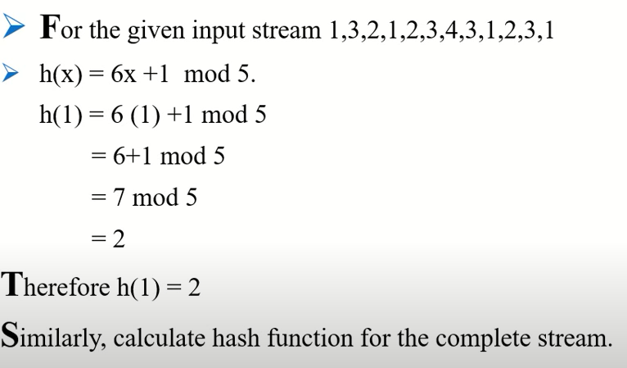

Flajolet-Martin Algorithm: Practical example
Calculate Hash function $h(x)$

Slide 43
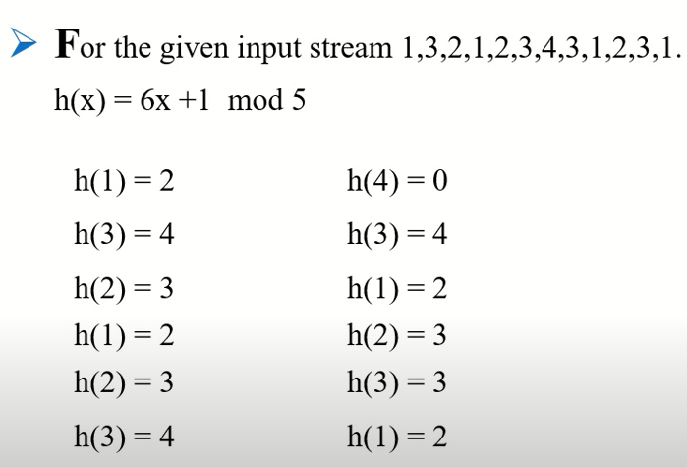
Flajolet-Martin Algorithm: Practical example
Calculate Hash function $h(x)$

Slide 44
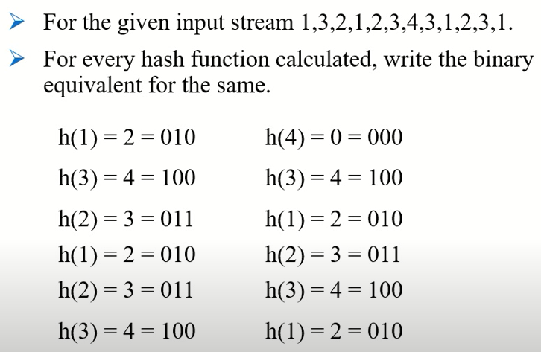
Flajolet-Martin Algorithm: Practical example
Binary bits

Slide 45
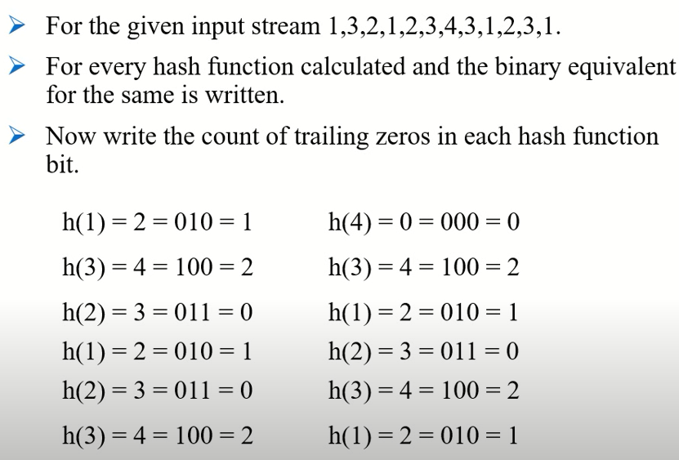
Flajolet-Martin Algorithm: Practical example
Trailing zeros

Slide 46
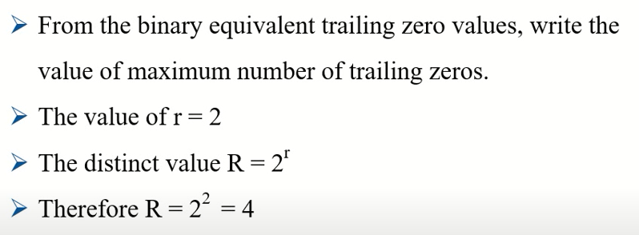
Flajolet-Martin Algorithm: Practical example
Distinct elements

Slide 47
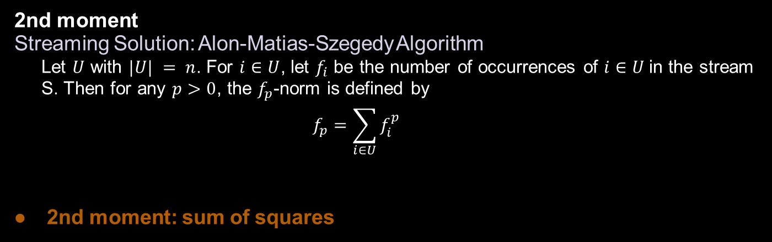
Counting Moments
2nd moment
Streaming Solution: Alon-Matias-Szegedy Algorithm
Let $U$ with $|U| = n$. For $i∈U$, let $f_{i}$ be the number of occurrences of $i∈U$in the stream S. Then for any $p>0$, the $f_{p}$-norm is defined by
$$f_{p}=\sum_{i∈U}{f_{i}^{p}}$$
2nd moment: sum of squares

Slide 48
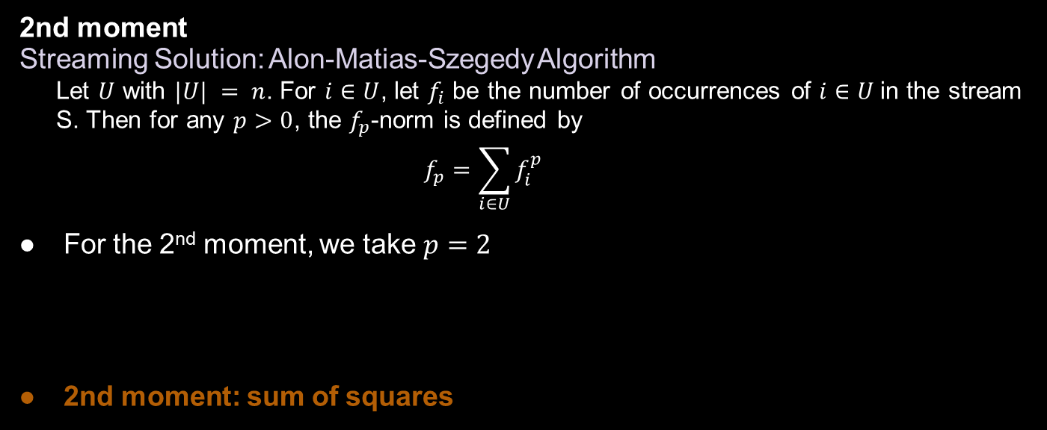
Counting Moments
2nd moment
Streaming Solution: Alon-Matias-Szegedy Algorithm
Let $U$ with $|U| = n$. For $i∈U$, let $f_{i}$ be the number of occurrences of $i∈U$in the stream S. Then for any $p>0$, the $f_{p}$-norm is defined by
$$f_{p}=\sum_{i∈U}{f_{i}^{p}}$$
For the 2nd moment, we take $p=2$
2nd moment: sum of squares

Slide 49
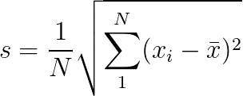
Counting Moments
standard deviation
(variance squared for numeric data)

Slide 50
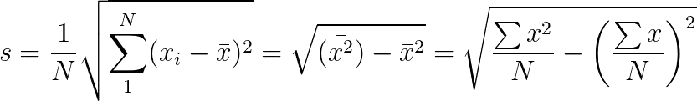
Counting Moments
standard deviation
(variance squared for numeric data)

Slide 51
Counting Moments
standard deviation
(variance squared for numeric data)
For streaming, just need to store
(1) number of elements, (2) sum of
elements, and (3) sum of squares.

Slide 52
Counting Moments
standard deviation
(variance squared for numeric data)
For streaming, just need to store
(1) number of elements, (2) sum of
However, challenge:
Sum of squares can blow up!
elements, and (3) sum of squares.

Slide 53
Streaming Topics
General Stream Processing Model
Sampling
approx. random
hierarchical approx. random
Counting Elements
distinct elements
mean, standard deviation

